Slide 1
S7
Weekly Deliverables
Jeffrey Novak

Slide 2
Week 1

Slide 3
Introduction
“What is the ‘Golden Age’(or ‘Dark Age’) of _____?”
This is a question that is both highly opinionated, and asked across many different pieces of media and genres.
Anime is no different in this regard. In fact, it can be much more difficult to answer in this case as anime is split into multiple different genres and categories, each with their own highs and lows.
The goal of this project is to attempt to find an answer to this question regarding anime using data provided on 15000 different entries.

Slide 4
Data profile
The dataset contains 15000 rows and 22 columns
Column Name | Has missing value? | Data Type(Discrete or numeric or free text) | Useful? | Need cleaning or processing?
anime_id | No | Numeric | No | No
anime_url | No | Free text | No | No
image_url | No | Free text | No | No
name | No | Free text | Yes | No
english_name | No | Free text | Yes | No
japanese_names | No | Free text | Yes | No

Slide 5
Data profile
The dataset contains 15000 rows and 22 columns
Column Name | Has missing value? | Data Type(Discrete or numeric or free text) | Useful? | Need cleaning or processing?
score | No | Numeric | Yes | No
genres | No | Free text | Yes | No
synopsis | No | Free text | No | No
type | No | Free text | No | No
episodes | No | Numeric | Yes | No
premiered | No | Free text | Yes | No

Slide 6
Data profile
The dataset contains 15000 rows and 22 columns
Column Name | Has missing value? | Data Type(Discrete or numeric or free text) | Useful? | Need cleaning or processing?
producers | No | Free text | Yes | No
studios | No | Free text | Yes | No
source | No | Free text | Yes | No
duration | No | Free text | Yes | No
rating | No | Free text | Yes | No
rank | No | Numeric | Yes | No

Slide 7
Data profile
The dataset contains 15000 rows and 22 columns
Column Name | Has missing value? | Data Type(Discrete or numeric or free text) | Useful? | Need cleaning or processing?
popularity | No | Numeric | Yes | No
favorites | No | Numeric | Yes | No
scored_by | No | Numeric | Yes | No
members | No | Numeric | Yes | No

Slide 8
Curious Questions
What was the best decade for anime by ratings?
Which decade did the highest rating anime of certain genres come out?
Which genres were the most popular per decade?
Which decades had caused possible stagnation for certain genres?
Are there any genres that have had little to no stagnation?
At what point were studios at their most popular?
What was the average amount of episodes in a series per decade?
How can this impact the overall score?

Slide 9
Audience
Anime fans
Helping narrow down which time period to look for when trying to find “top rated” shows in a certain genre.
Helping better understand the history of certain genres and possibly the medium as a whole.
Producers and studios
Finding which genres are currently popular, along with what genres were previously popular in previous years.

Slide 10
Communication goals
My personal goal with this project is both better understand and explain the history of anime using data. Giving insight such as which genres and studios were the most prevalent at certain times, and if they are still as prevalent as to this day. What trends were previously popular in shows compared to trends that are seen today.

Slide 11
Week 2

Slide 12
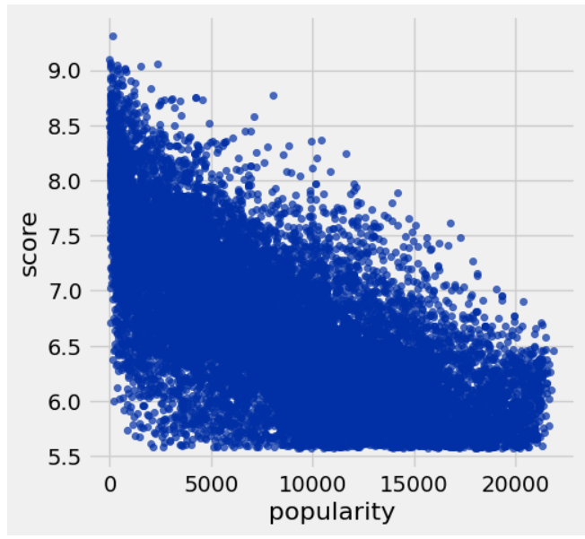
Score in relation to popularity
My first choice of action was to determine wether I would be using score or popularity to determine how the anime would be ranked by a period of time.
The following is a scatter plot comparing the popularity of the anime in the database to their overall score. The x-axis represents popularity, with lower numbers representing a higher popularity rating, and the y-axis representing the score.
Observing the plot and graph, there is noticeable variation in the popularity in relation to score. The Anime ranked 5th highest in popularity is ranked 174th in score. Knowing that, I made the conclusion that popularity and score do not have as much correlation as I assumed they would. Because of this, I will have to designate rankings based on both popularity and ratings as separate categories going forwards.

Slide 13
Progress
Although small, I did manage to get some information for the project. I will have to put in more effort next week to make up for this.
I feel that the biggest obstacle for me has been management. This is something that I personally struggle with across many different classes, including this one. I should try to divide the workload across the week to avoid overwhelming myself, while also possibly getting better results.
I used Juptyerlab, the datasheet, and the instructions for this week.

Slide 14
Feedback response
The feedback I was given was regarding the communication goals, and how I should have perceived them from an audience perspective. I worded it to sound like a personal goal, when it should be open for other people. This feedback is very useful to me, as it helps me better understand my goals for the project going forward. Instead of wording it as a personal goal, I could have worded it as a solution to a question that is very popular among both anime fans and studios.
Going forward, I would like to see more feedback related to data needed and used. I feel I have underperformed so far, and would like to improve myself in this regard.

Slide 15
Week 3

Slide 16
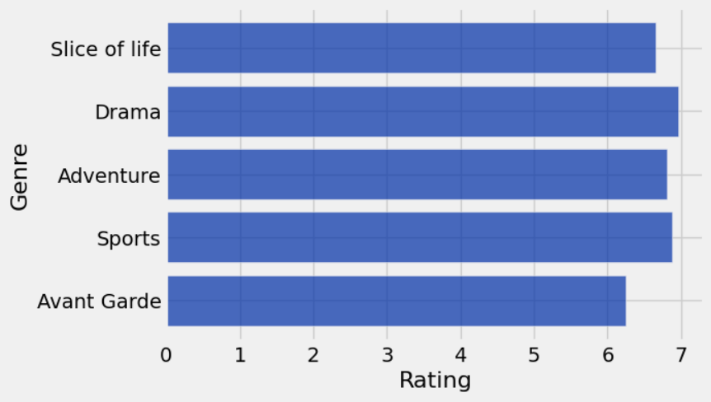
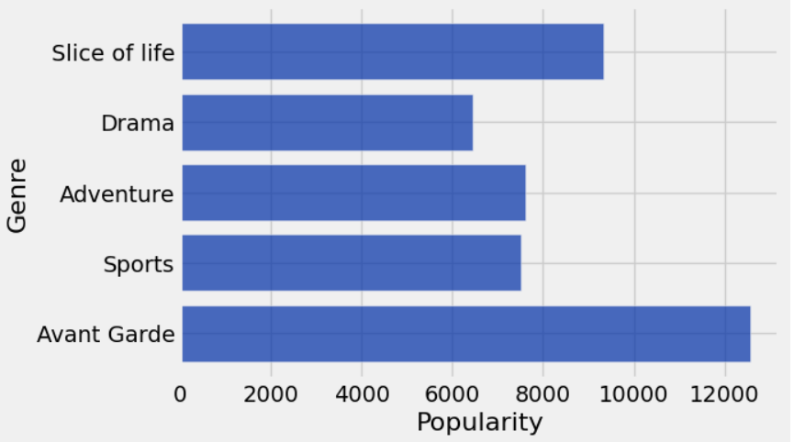
Averages per genre
I decided to focus on the following genres for my project
Drama
Adventure
Sports
Slice of Life
Avant Garde
I chose to do the averages for both ratings and popularity.
The difference between the ratings and popularity graph helped verify my belief from week 2 that ratings and popularity are measured differently.

Slide 17
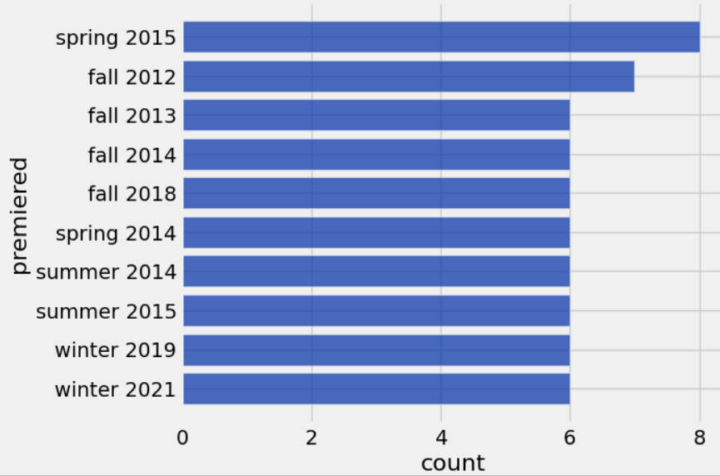
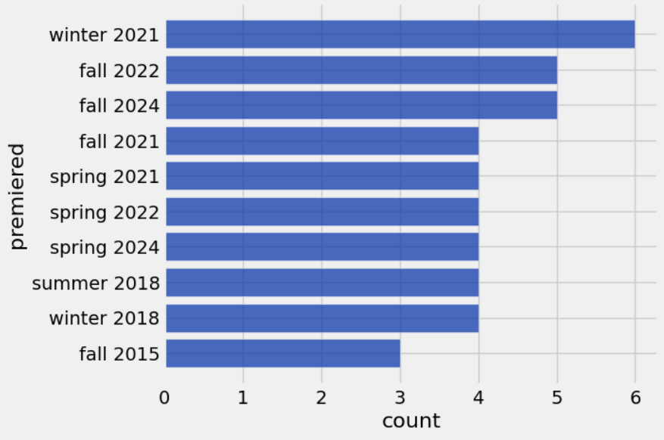
Most common premiere dates among the top ranks
I grabbed the premiere periods for both the top 50 most popular and highest ranked animes from the database. I received differing results from both of the tables. The highest scoring anime seem to come recently in the past few years, while the most popular are from the mid to late 2010s.
This gives me an idea of where to look for the respective variables.

Slide 18
Progress
I ran into some issues with the genres overlapping each other. This could cause issues with trying to compare data later on. My proposed solutions were to either clean the data further to try and get more accurate results, or try and use genres that were not as broad (i.e. drama, adventure).
I also found some data was missing from table when I looked deeper into it. This too could lead to issues when trying to sort data.
That bring said, I did manage to find some averages for the data this week that could be useful in the future. The data collected for this week is broad, so the process going forward will involve getting more specific.

Slide 19
Feedback response
Although I am still somewhat behind in terms of progress, I have started to make more progress by including 2 insight slides. Going forward, I believe that I will have to include 3 insight slides for each week in order to make the required process in order to catch up.
As for the graph, I do believe that I could have made it more comprehensive, or have used a different graph type to represent my point.
The feedback was very useful, and I would still like to see feedback related to the data used, as I feel there is still work that can be done.

Slide 20
Week 4

Slide 21
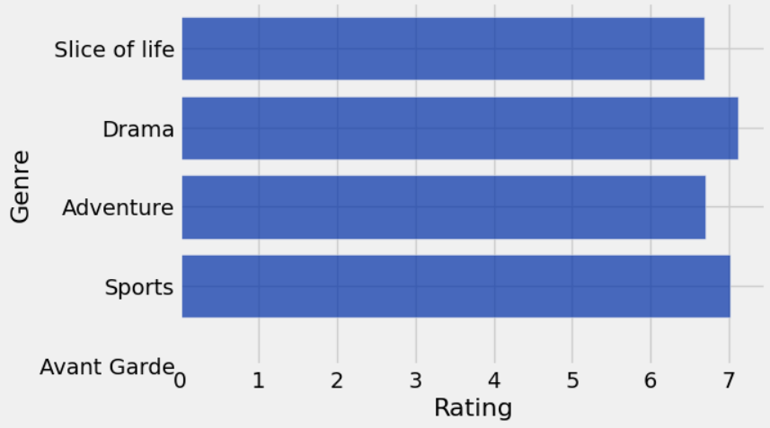
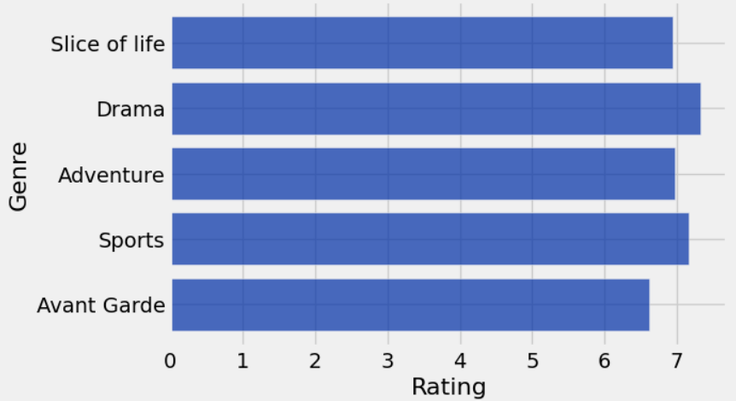
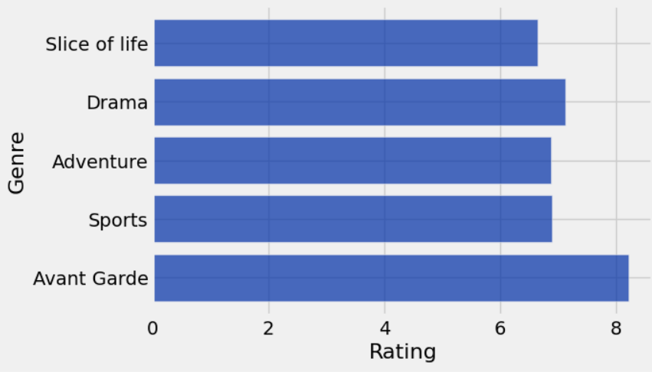
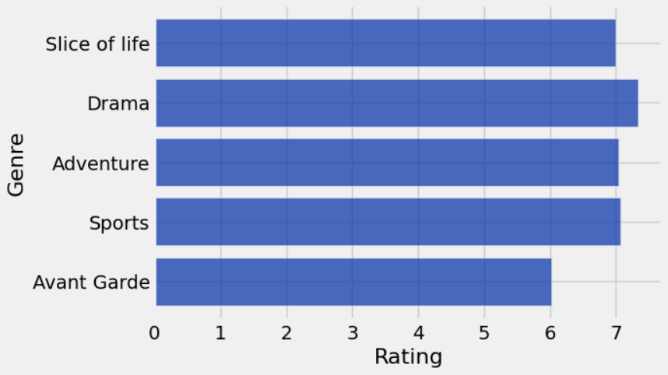
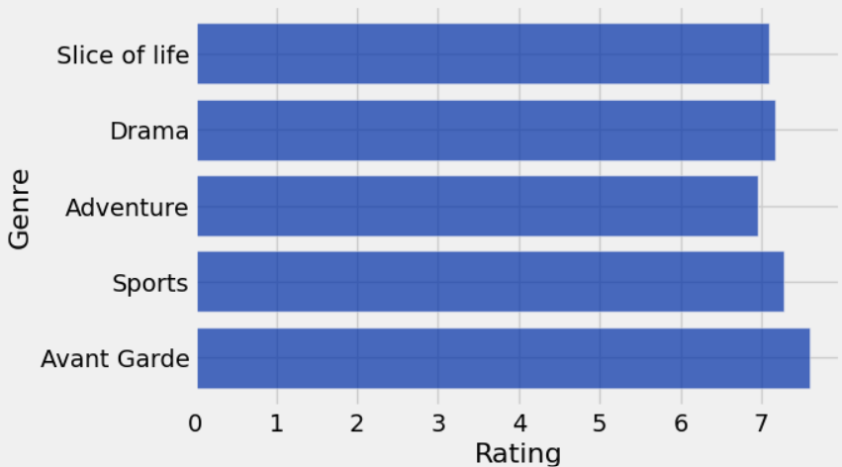
Genres average score by decade
The three images on the left represent the average score per genre from the 1980s, 1990s, and 2000s from top to bottom. The two images on the right represent the average score from the 2010s on top and the 2020 on the bottom.
I found the following things:
The average score for many genres was around 7 across all decades.
I would need to get more specific with the data if I wanted to find anything else worth noting.

Slide 22
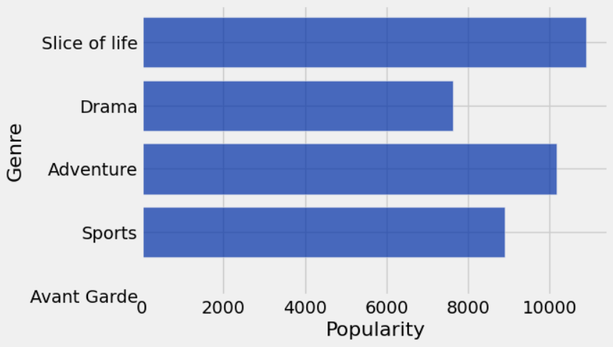
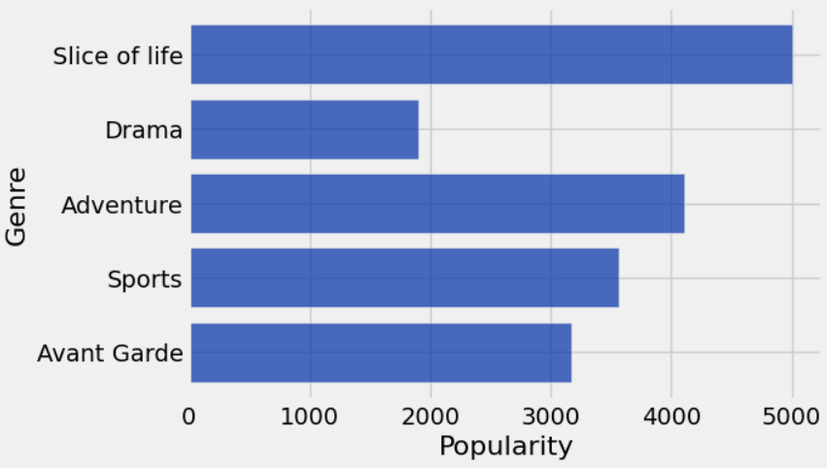
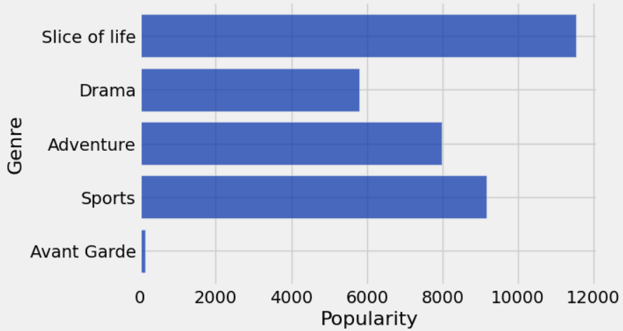
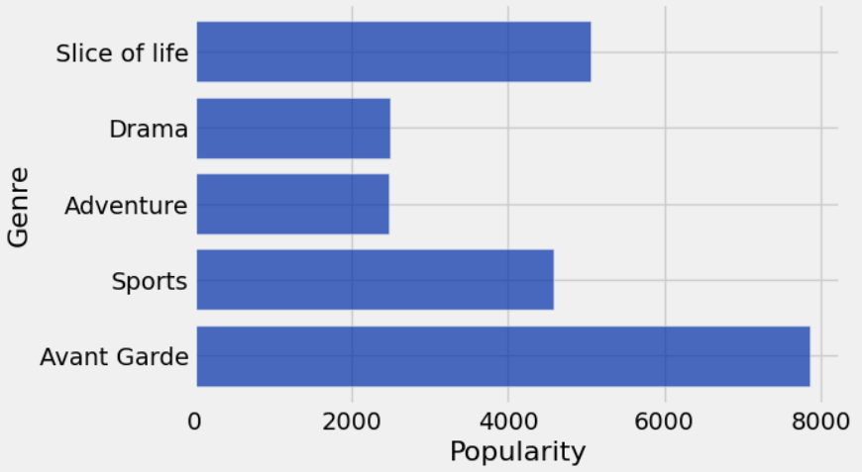
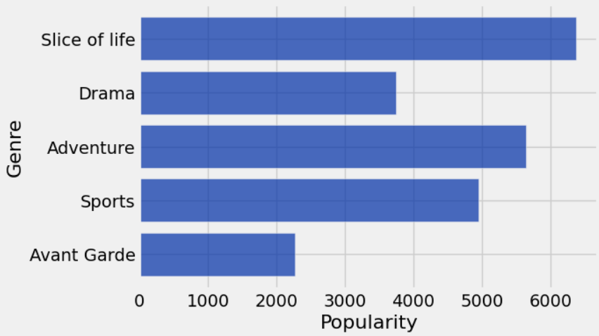
Genres popularity score by decade
The three images on the left represent the average popularity ranking per genre from the 1980s, 1990s, and 2000s from top to bottom. The two images on the right represent the average popularity ranking from the 2010s on top and the 2020 on the bottom.
I found the following things:
Avant Garde’s average seemed to be the unusually popular during the 90s
This can be attributed to a show with high popularity being in a genre that does not have many shows.
Adventure and Drama seemed to gain noticeable popularity during the 2010s and 2020s
Slice of Life started to become popular starting in the 2000s

Slide 23
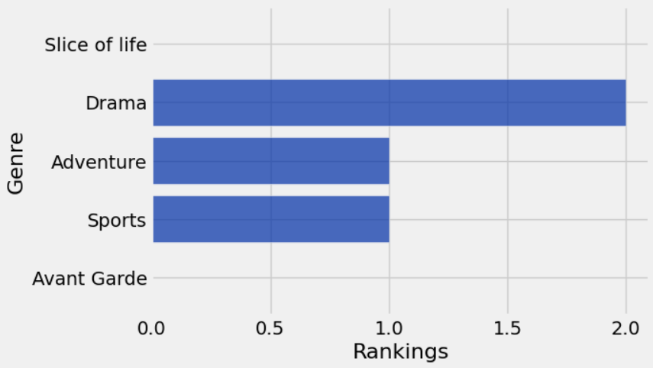
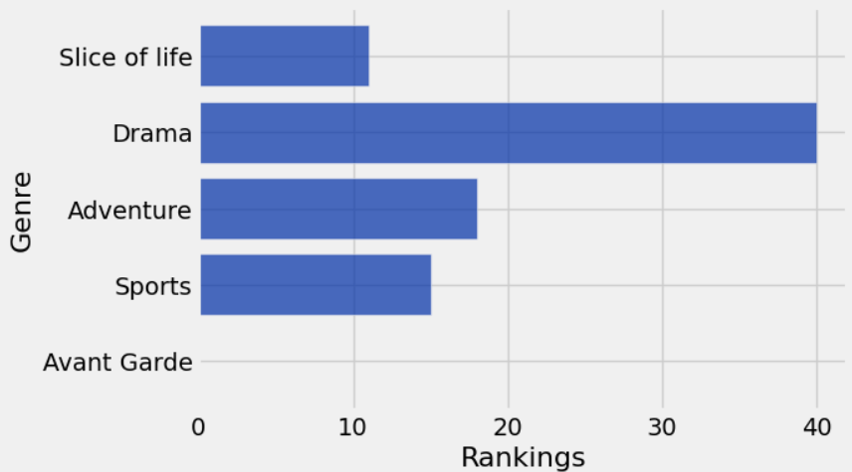
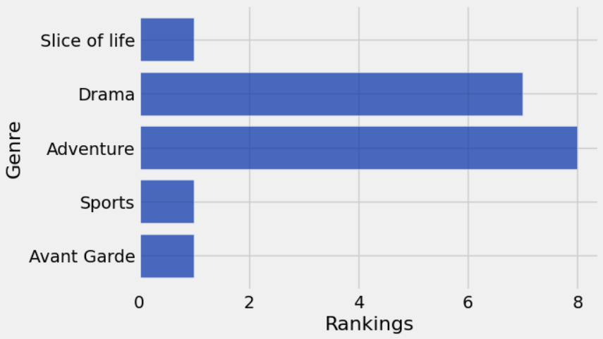
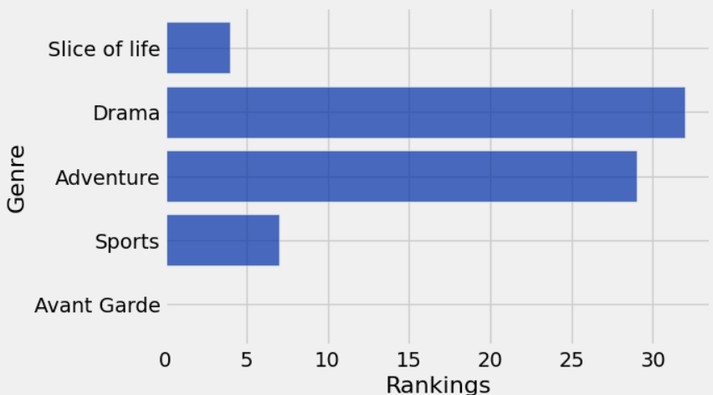
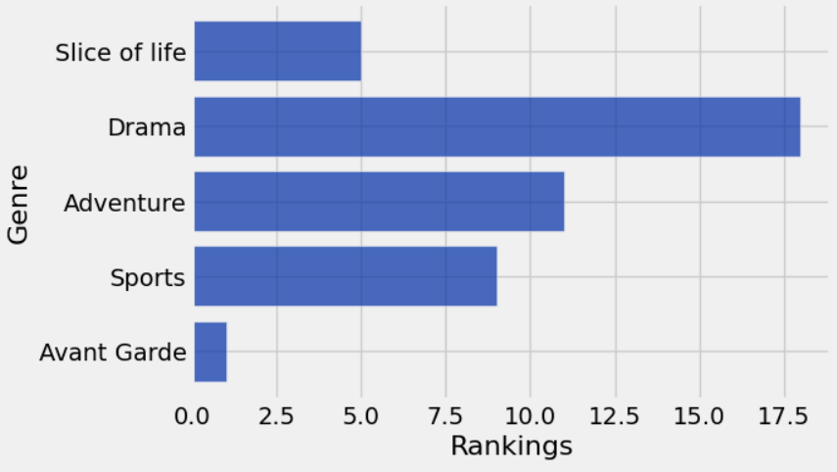
Frequency of top 500 ranking by decades
Using the same image structure as the last two slides, the following is a number of how many anime are ranked in the top 500 by decade.
I found the following things:
Avant Garde is an uncommon genre
This can explain the inconsistencies between the popularity and score for the genre displayed on the previous slides
Many of the top 500 shows seemed to be produced from the 2000s onward.
This gives me a possible lead by telling me that the 2000s would be worth looking into for more answers on ranking by score.

Slide 24
Progress
I feel I made significant progress for this week. I was able to successfully sort by decades, which will be very useful going forward in this project.
There are admittedly some issues from last week that I am yet to resolve. I still feel I need to fix the issues of the genres potentially giving less accurate averages by overlapping. And I still feel that the data being displayed overall in the graphs is too broad.
Looking past that, this should be the final piece of “broad” data that I need to gather to help with my story. Going forward I will have to dedicate more time as the data gets more and more specific.

Slide 25
Feedback response
Personally I chose those 5 because I wanted 3 common genres(Drama, Adventure, Slice of Life) and 2 genres that are more niche(Sports and Avant Garde).
I am thankful for the recommendation to use other types of plots. I feel that I have been using mostly bar graphs for the majority of this project and should look into other forms of graphing as well.
The feedback was still very valuable to me. I would personally like to see more graph recommendations so I understand what other graphs I can integrate into my project’s research.

Slide 26
Week 5

Slide 27
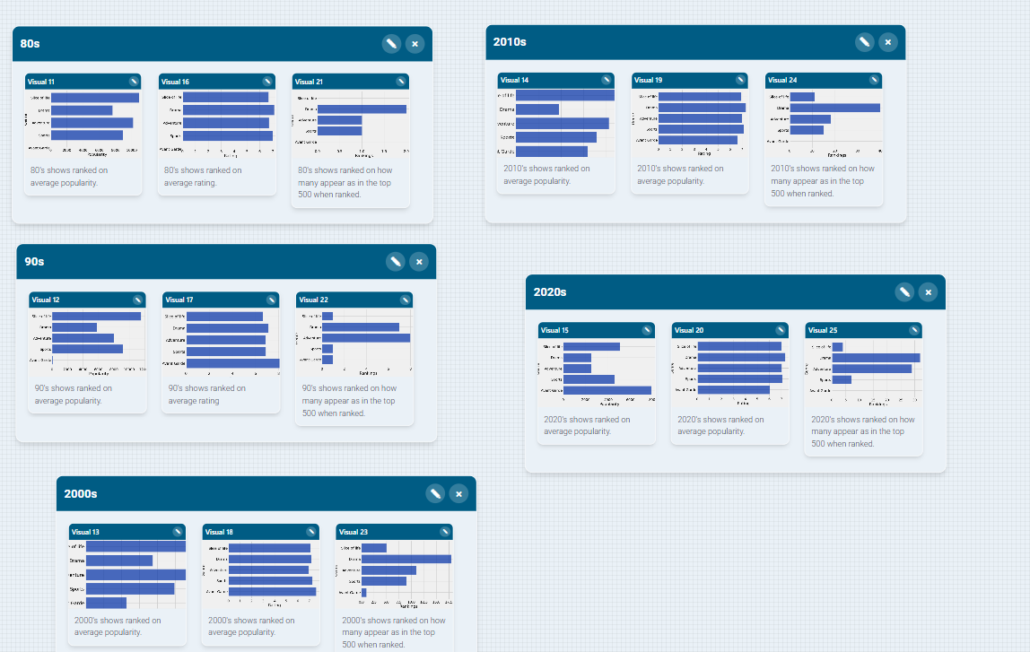
Storyboard
The storyboard I created provides the previously shown ratings, popularity, and ranking by decades. Being able to view the data in this format has made me realize a few things.
I found that:
Average popularity gave more insight into what makes frequently high ranked shows compared to the average ratings.
2000s, 2010s, and 2020s show a possible correlation between a high popularity rating leading to a higher number of highly ranked shows.
Popularity could possibly be a more important than variable to measure than ratings.
Popularity has been rapidly increasing in almost all genres measured.
Sports and Adventure have been consistently growing in popularity, while Slice of Life and Drama have seen similar results with the exception of one decade.
Despite the varying popularity and rankings, ratings did not show much variation.
Many hovered around an average of 7.
Deeper cleaning of the data might be required in order to get any value from the average rating.

Slide 28
Micro Data Story
Working on slides 22 and 23 made me realize something, it's hard to find a ‘golden age’ in a medium that is constantly managing to out-perform itself. While the ratings slide didn’t provide many details for me, the popularity slides did help me form a narrative. That being, in terms of popularity, we are in a golden age and it’s showing no signs of slowing down.
Genres such as sports and adventure have been consistently becoming more and more popular over the decades. And other genres have seen similar results with one exception, such as slice of life’s popularity with the exception of the 70s to the 80s, and dramas popularity from the 2010s to the 2020s. There has also been an increase in top rated shows over the decades, with the 2010s and 2020s having the most amount of the top 500 ranked anime. I bring all this up to demonstrate how anime has gone mainstream in terms of popularity. I also bring this up because it keeps managing to out-perform itself, with more top rated shows being released as time goes on.
This all made me ask a different question, maybe instead of looking into “when” I could try looking at “where” and “why” going forward. What era did anime begin to go mainstream? And what animes pioneered the genre and allowed for it to happen? And although it might be out of the jurisdiction of data science, were there any real-world factors that contributed?

Slide 29
Progress
This week had me begin to properly construct the narrative for my PI project. I was able to use StoryStudio and the visuals to display a coherent narrative. I also asked myself questions about the popularity ratings, and might have found another possible lead that I could look into.
The only real issue is because I was preoccupied with the StoryStudio and constructing a narrative, I wasn’t able to find and visualize as much data for this week. I hope I can resolve this problem by doing more research going forward. I also had some problems with importing the visuals into StoryStudio. Also, for some reason, the graphs for the 2000s and 2010s popularity would not fully show up, so I could not screenshot them entirely.
Overall, I think I did just okay for this week. I feel that the narrative created can answer some of the questions I asked when starting the PI project, as well as create some new ones.

Slide 30
Feedback response
I should have taken layered graphs into account when creating the visuals to help with clarity. Although I did want more on other types of graphs besides bar graphs, it’s still important to make sure that I am using bar graphs right when I do use them. This information was valuable to me, and I will take note of it for future cases.
As for future feedback, I would like to hear about the possibility of me looking to the questions proposed in the final section of the micro data story. I believe that finding these answers can possibly help with the narrative, but also understand that it could be off-topic from what the PI project originally aimed to answer.

